Slide 1
How to Pygame
By Joseph Brason 11J

Slide 2
What is Pygame?
Pygame is a cross-platform set of Python modules designed for writing video games. It includes computer graphics and sound libraries designed to be used with the Python programming language.
Source: https://en.wikipedia.org/wiki/Pygame

Slide 3
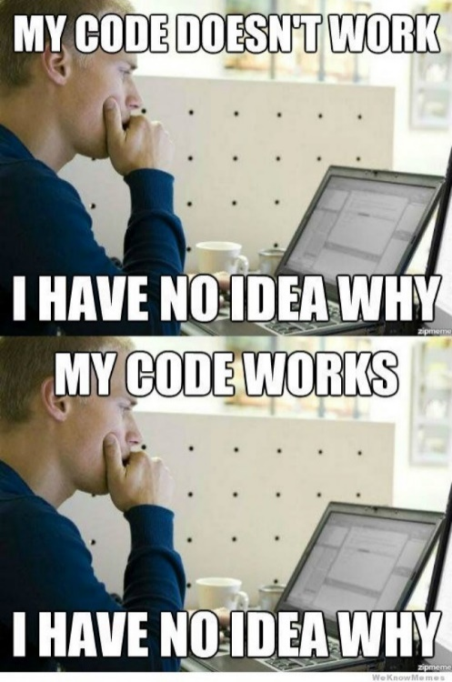
Things you will encounter
Comments - #s
for and while loops
Lists – []
Conditional statements - if, elif, else etc.
Functions - random.randint()
imports – import pygame, time
Self-defined functions – def, class
Global variables – global
Trying collisions
Sprites (eventually)
Sprite groups
Using maths – yay!
Bugs
Bugs
And more bugs…

Slide 4

How scripts will be shown
print(“Hello World”)
for x in range(0,5): print('Example')
1 2 3

Slide 5
Getting Started
On any blank Python file, the first two things you need to do to start using Pygame are:
Import Pygame
Initiate Pygame
To do this…
import pygame
from pygame.locals import *
pygame.init()
1234

Slide 6
Limiting FPS
clock = pygame.time.Clock()
This is important, because in most projects you won't want your game to run as fast as it can, and in 20 years time, the projects would run too fast
6

Slide 7
Setting the screen up
screenX = 1200
screenY = 720
8
9
10
This makes a window appear which will just close when the script is finished.
screen = pygame.display.set_mode((screenX, screenY))

Slide 8
Window Name
12
13
windowTitle = "Blank Pygame window"
pygame.display.set_caption(windowTitle)
You can just type in a string instead of creating a variable, however if you want to change the window name later, it will be easier because of this one additional line of code. Feel free to change the windowTitle to whatever you want

Slide 9
Colours
15
16
#COLOURS
black = pygame.Color(0,0,0)
The only use of colours in this script is to fill the screen. In other projects, you will use colours for all your visuals.

Slide 10
The mainLoop
17
18
19
20
def mainLoop():
pygame.display.flip()
screen.fill(black)
clock.tick(60)
This is where all your functions, and all your code, is gathered for executing.

Slide 11
Running in circles
22
23
while True:
mainLoop()
This is an infinite loop, and while you've been told to stay clear of them, Pygame uses other methods of breaking out.

Slide 12
Overview
RUN YOUR SCRIPT
You should now have an unresponsive black screen. It's not really unresponsive, but all it's doing is filling the screen in black, then updating itself, which makes no visible change. The close tab button won't work either, because we haven't coded that yet. Notice though that the window title is what you wanted, so I'd call it a successful script.

Slide 13
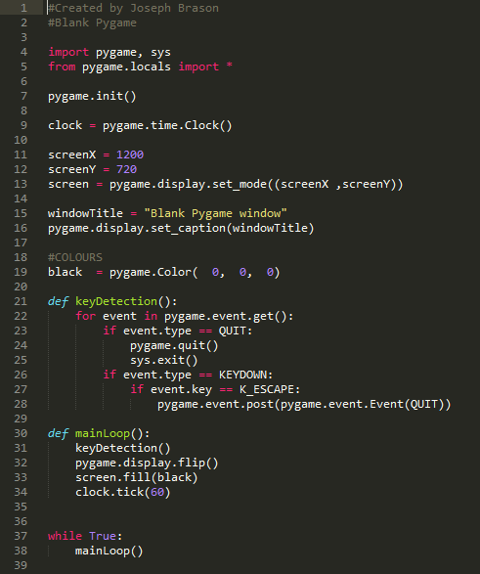
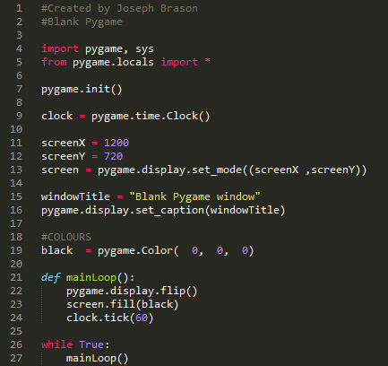
What it should look like

Slide 14
Simple Key detections
Change
1 import pygame
to
1 import pygame, sys
Too long to explain sys on PowerPoint
Demo: Events.py

Slide 15
All key detections
for event in pygame.event.get():
if event.type == QUIT:
pygame.quit()
sys.exit()
if event.type == KEYDOWN:
print(event)

Slide 16
All key detections
for event in pygame.event.get():
if event.type == QUIT:
pygame.quit()
sys.exit()
if event.type == KEYDOWN:
if event.key == K_DOWN:
pass
if event.key == K_UP:
pass
if event.key == K_LEFT: pass
if event.key == K_RIGHT:
pass
if event.key == ord('s'): pass
if event.key == ord('w'):
pass
if event.key == ord('a'):
pass
if event.key == ord('d'):
pass

Slide 17
Changing Screen Colour
TASK: Use inputs to change the screen colour. Think about how you might create a variable, then fill the screen in the colour of that variable, and change it based on inputs

